Slide 1
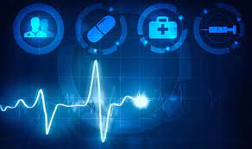
SMART HEALTH PREDICTION SYSTEM
DOMAIN:
MACHINE LEARNING
MENTOR: Shivani
MEMBERS:
DEEPAK GOSWAMI 1900290120033
LOVELY MANGAL 1900290120058
MOHD ZUBAIR 1900290120065

Slide 2
Problem Statement
The machine learning plays a vital role in diseases Prediction while designing “Health prediction System". However, no single machine learning algorithm is best suited to resolve the prediction issues for all healthcare datasets. The combination of several machine learning algorithms or hybrid version of the machine learning algorithm may be the better approach to get best prediction of diseases. Though accuracy is increased by considerable amount, there is further room for improvements in accuracy of models. The future may be in designing a better machine learning model that can address healthcare with real time healthcare dataset. This study comprise the complete analysis of all the existing data algorithms and dataset.

Slide 3
OBJECTIVE
Nowadays health issues are quite common. We need a model which can predict the disease accurately on the basis of symptoms and help in early treatment and saves vital organs from damaging .
This paper talks about the utilization of Machine Learning in the area of healthcare. Different types of algorithms can be used in the field of Research and Education also. The major reason to use Machine Learning in healthcare system is to advance new automated tool for determining and diffusing health care information. The model is trained with various diseases. According to input symptoms, the model predicts the relevant disease. In this model algorithms such as Naive Bayes algorithm, Regression, decision tree, K-neighbors, SVM have been used for prediction and visualization. The goal is to develop easily accessible healthcare system for patients.

Slide 4
METHODOLOGY
The Methodology is to implement “ Healthcare Prediction System” via Machine Learning techniques, which includes Naïve Bayes Classifier, Support Vector Classifier, Decision Tree, K-Neighbors Classifier, and Logistic Regression. This procedure can be termed as ‘Knowledge Discovery Process’, this process include:
Data Selection : Data selection is the process of determining the appropriate source of data and its data type. Data selection process is the actual practice of data collection. This definition differentiate data selection from selectively excluding data that is not useful for research hypothesis. This step include sorting reliable information into files, gathering information from online databases like Kaggle, Datahub, UCI etc

Slide 5
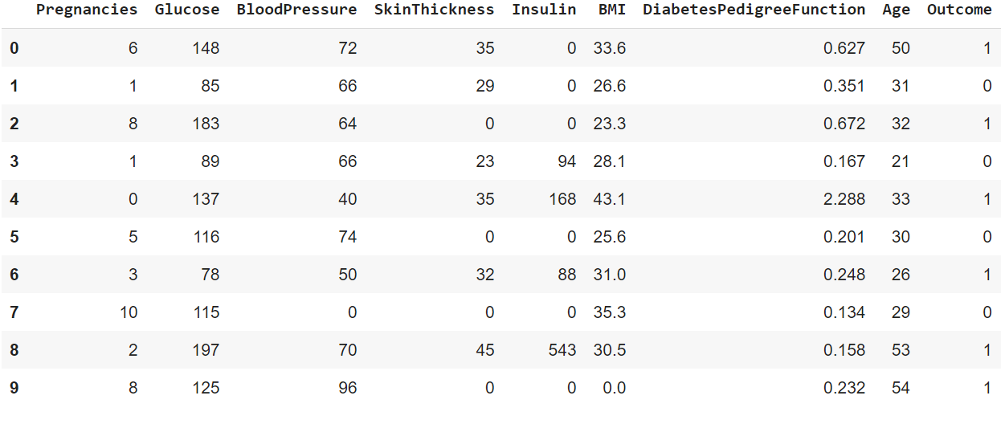
Fig 1: Diabetes Dataset

Slide 6
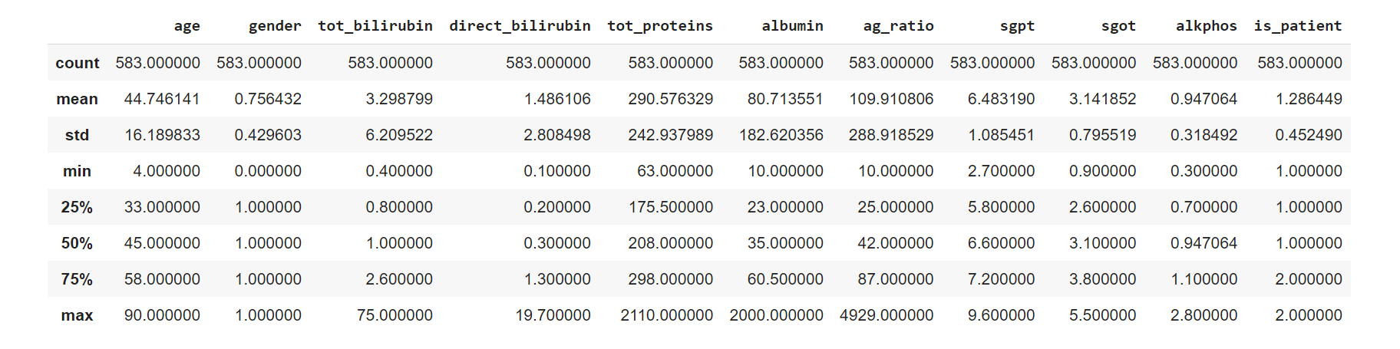
Fig 2: Liver Dataset

Slide 7
Data Preprocessing
This step comprises altering stored data into clean data. Pre-Processed files contains uneven, biased, partial and/or missing information, which might affect models’ accuracy or might make our model biased . In order to overcome this obstacle we have used following libraries :
Pandas : To read and transform data for further data cleaning.
Numpy : To clean and transform data for machine learning models.
Sklearn : To split data into testing and training data and to make different machine learning models. Matplotlib : For visual representation of data and comparison of models

Slide 8
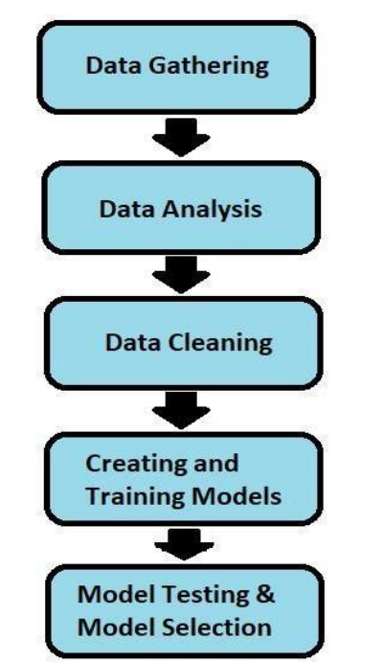
Fig. 3: Proposed Model

Slide 9
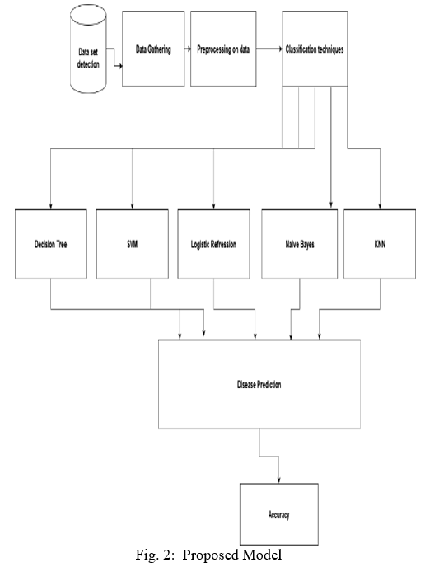
Fig. 4: Proposed Model

Slide 10
ALGORITHM USED
Naive Bayes- Naive Bayes classifiers are a collection of classification algorithms based on Bayes’ Theorem. It is not a single algorithm but a family of algorithms where all of them share a common principle, i.e. every pair of features being classified is independent of each other.
Support Vector Machine- SVM is supervised learning algorithm.The goal of the SVM algorithm is to create the best line or decision boundary that can segregate n-dimensional space into classes so that we can easily put the new data point in the correct category in the future. This best decision boundary is called a hyperplane.SVM chooses the extreme points/vectors that help in creating the hyperplane. These extreme cases are called as support vectors, and hence algorithm is termed as Support Vector Machine.

Slide 11
K-Nearest Neighbor- KNN is one of the simplest Machine Learning algorithms based on Supervised Learning technique. K-NN algorithm assumes the similarity between the new case/data and available cases and put the new case into the category that is most similar to the available categories. K-NN algorithm stores all the available data and classifies a new data point based on the similarity. This means when new data appears then it can be easily classified into a well suite category by using K- NN algorithm. K-NN algorithm can be used for Regression as well as for Classification but mostly it is used for the Classification problems.

Slide 12
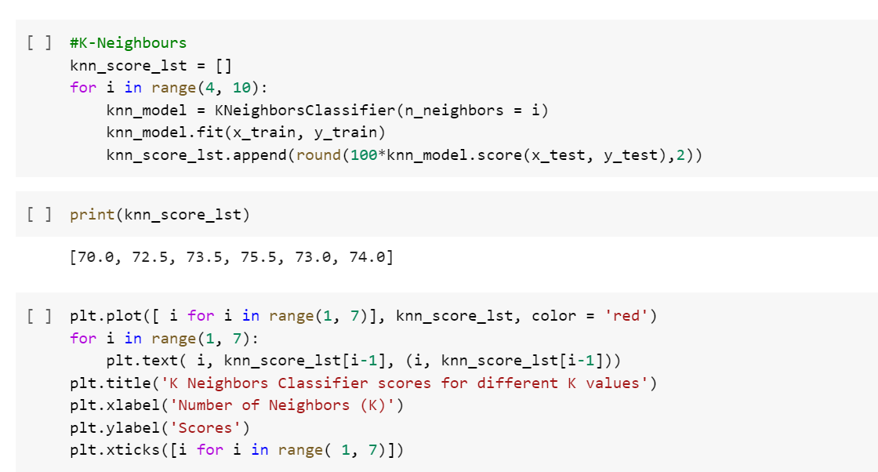
Fig.4: K-neighbors

Slide 13
Decision Tree-
Decision Tree algorithm belongs to the family of supervised learning algorithms. Unlike other supervised learning algorithms, the decision tree algorithm can be used for solving regression and classification problems too.
The goal of using a Decision Tree is to create a training model that can use to predict the class or value of the target variable by learning simple decision rules inferred from prior data(training data).
In Decision Trees, for predicting a class label for a record we start from the root of the tree. We compare the values of the root attribute with the record’s attribute. On the basis of comparison, we follow the branch corresponding to that value and jump to the next node.

Slide 14
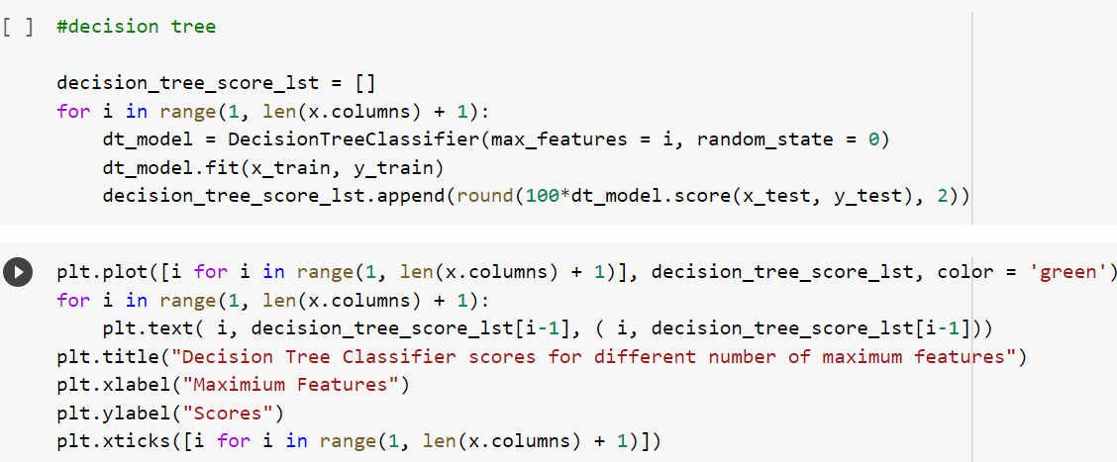
Fig. 5: Decision Tree

Slide 15
LOGISTIC REGRESSION-
Logistic regression is one of the most popular Machine Learning algorithms, which comes under the Supervised Learning technique. It is used for predicting the categorical dependent variable using a given set of independent variables.
Logistic regression predicts the output of a categorical dependent variable. Therefore the outcome must be a categorical or discrete value. It can be either Yes or No, 0 or 1, true or False, etc. but instead of giving the exact value as 0 and 1, it gives the probabilistic values which lie between 0 and 1.
Logistic Regression is much similar to the Linear Regression except that how they are used. Linear Regression is used for solving Regression problems, whereas Logistic regression is used for solving the classification problems.

Slide 16
HARDWARE REQUIREMENT
Processor: Intel i3 OR i5 OR i7
RAM: _4 or 8

Slide 17
SOFTWARE REQUIREMENT
Python
Jupyter Notebook
SQL Server
HTML5
CSS
Window 7 and above.

Slide 18
ADVANTAGE
This system helps to reduce the waiting time of the patient.
Users can select the appointment time according to his preference.
Available and booked slots are shown in effective graphical user interface.

Slide 19
DISADVANTAGE
This application requires active internet connection.
User need to put correct data or else it behaves abnormally.

Slide 20
APPLICATION OF PROJECT
Predict the amount of possibility of have a particular type of disease.
Create the database of the user medical history
Enhance the medical field.

Slide 21
OUTCOME OF THE PROJECT
Predict the amount of possibility of having a particular type of disease.
Create the database of the user medical history.

Slide 22
THANK YOU

